Slide 1



Binary pulsars as probes of a Galactic dark matter disk
Andrea Caputo
University of Cagliari, November 2017
Talk based on A.C, Jesus Zavala, Diego Blas “Binary pulsars as probes of a Galactid dark matter disk” (Phys.Dark Univ. 19(2018) 1-11)

Slide 2
Outline:
Introduction:
Dark Matter (DM) evidence
Motion of binaries and orbital period variation
Binary pulsar
Numerical Results
I Approach, neglecting wake pair interaction:
Standard scenario
PIDM, Dark Disk scenario
II Approach, wakes interaction into the game
Conclusions

Slide 3
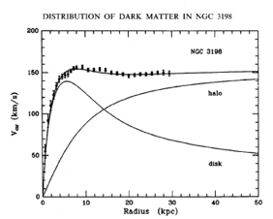
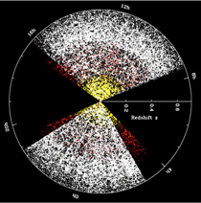
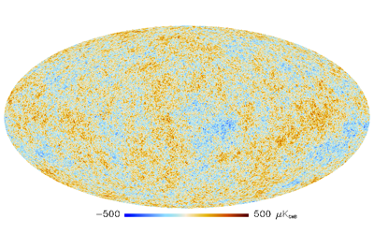
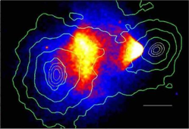
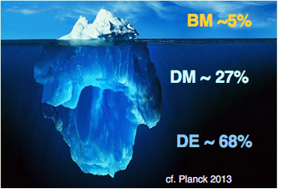
Dark matter evidence
Rotation curves
Structure formation
Lensing
CMB
Unravelling the nature of DM is one of the most fundamental frontiers of modern physics

Slide 4
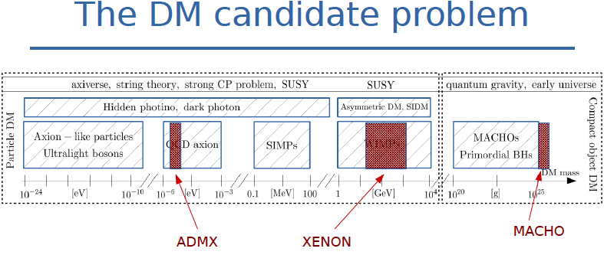
Dark matter candidates
Massive Astrophysical Compact Halo Object (MACHO)
ADMX
CAST
XENON
CDMS
DAMA

Slide 5
Given the lack of signatures of non-gravitational Dark Matter interactions, the gravity exerted by Dark Matter on ordinary matter remains the only guiding source of observational information

Slide 6
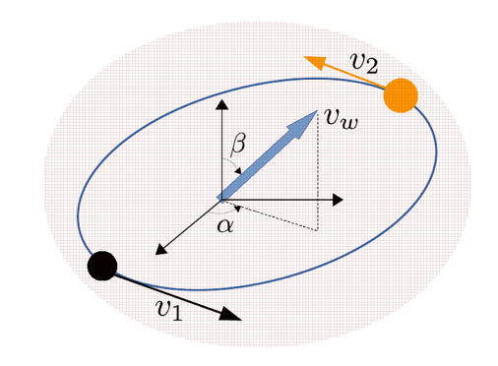
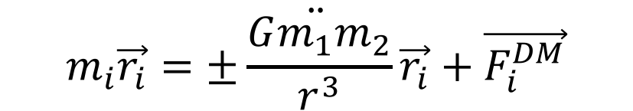

Does dm effect the motion of binaries?
Pani, 2015
Chandrasekhar, 1940s
Bekenstein & Zamir, 1990
$$\ddot{m_{i}\vec{r_{i}}=±\frac{Gm_{1}m_{2}}{r^{3}}\vec{r_{i}}+\vec{F_{i}^{DM}}}$$
Gravitational drag force on the i-th object
Slow perturbers
$$\frac{d\vec{v}}{dt}∝−\frac{G^{2}(m_{i}+m_{DM})m_{DM}\vec{v}}{v^{3}}\left[\int_{0}^{v}{d^{3}uf\left(u\right)\left(\log\left(qu^{2}\right)+\log\left(\frac{v^{2}−u^{2}}{v^{2}}\right)\right)+\int_{v}^{∞}{d^{3}uf(u)\left(−\frac{2v}{u}+log⁡(\frac{u+v}{u−v})\right)}}\right]$$
$$m_{DM}f(u)$$
DM density distribution
Fast perturbers

Slide 7
Perturbation theory
Osculating orbits formalism ( see E. Poisson and C.Will (2014))
Correction to circular orbits
Kepler’s third law

Slide 8
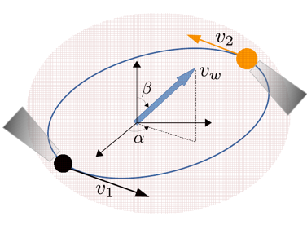
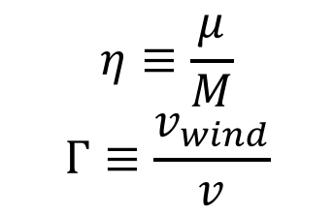
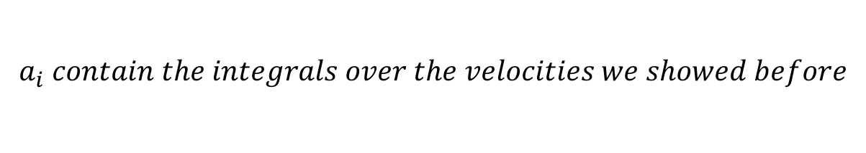
Orbital period variation
angles between DM wind and orbital plane
orbital period
$${\dot{P}}_{b}^{DM}(t)=3P_{b}\left[a_{1}η−a_{2}Γsinβsin⁡(Ω_{0}t−α)\right]$$
zeroth order orbital angular velocity
$$η≡\frac{μ}{M}$$
$$Γ≡\frac{v_{wind}}{v}$$
$$a_{i} contain the integrals over the velocities we showed before$$

Slide 9
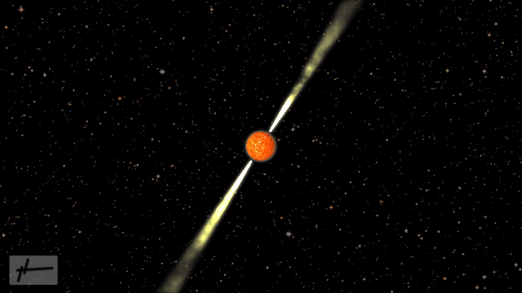
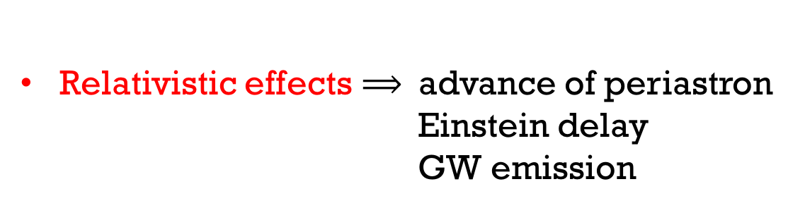
Binary pulsar
Pulsars are neutron stars with strong electromagnetic emission
Cosmic clocks
Keplerian orbital parameters derived from pulsar timing are 1000 times more precise than derived from Doppler measurements
Relativistic effects $⟹$advance of periastron
Einstein delay
GW emission
D. R. Lorimer and M. Kramer, Handbook of Pulsar Astronomy, by D. R. Lorimer , M. Kramer, Cambridge, UK: Cambridge University Press, 2012 (2012)

Slide 10
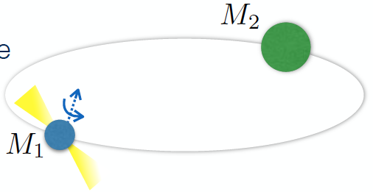
Binary pulsar
Pulsars are neutron stars with strong, anisotropic electromagnetic emission
Cosmic clocks
Keplerian orbital parameters derived from pulsar timing are 1000 times more precise than derived from Doppler measurements
Relativistic effects $⟹$advance of periastron
Einstein delay
GW emission
D. R. Lorimer and M. Kramer, Handbook of Pulsar Astronomy, by D. R. Lorimer , M. Kramer, Cambridge, UK: Cambridge University Press, 2012 (2012)

Slide 11
Results in a standard dm scenario

Slide 12
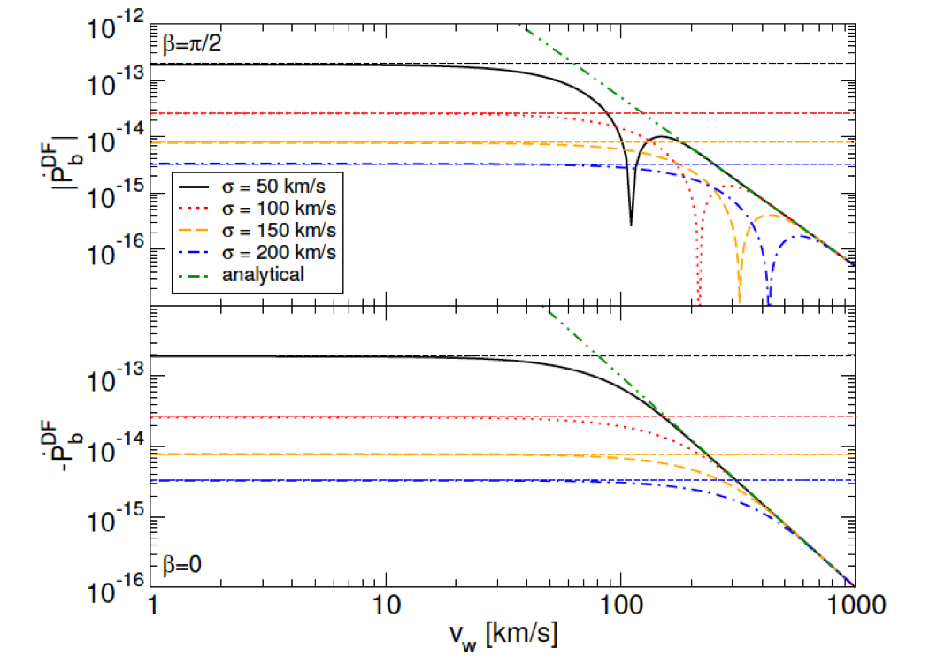


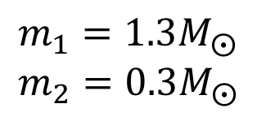
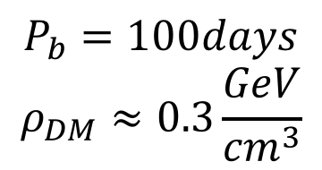



$$D\sim 5kpc$$
DM velocity dispersion
$$σ(Km/s)$$
$${\dot{P}}_{B}^{DM}≈−2.9∙{10}^{−18}$$
$$m_{1}=1.3M_{⨀}$$
$$m_{2}=0.3M_{⨀}$$
$$P_{b}=100days$$
$$ρ_{DM}≈0.3\frac{GeV}{{cm}^{3}}$$
$$σ\sim v_{w}\sim 100Km/s$$
Pani, Paolo Phys.Rev. D92 (2015) no.12, 123530 arXiv:1512.01236
The signal is too weak!but..
Interesting dependence on $σ, ρ_{DM} and v_{wind}$!

Slide 13
DARK DISK Scenario

Slide 14
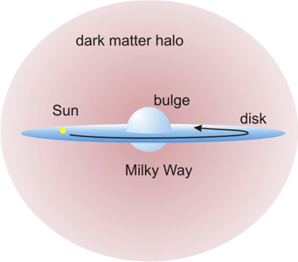
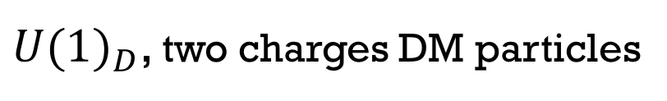
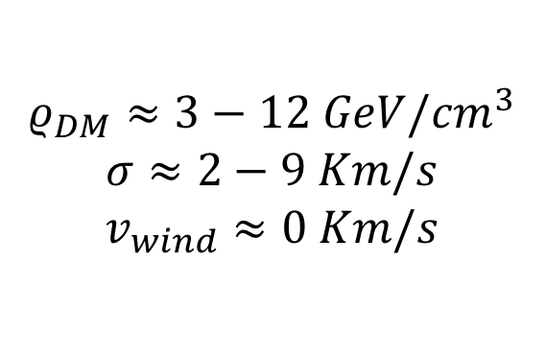
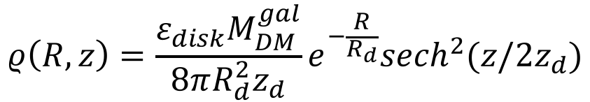

J. Fan, A. Katz, L. Randall, and M. Reece, Phys. Dark Univ. 2, 139 (2013), arXiv:1303.1521
More complex DM can generate a dark disk, corotating with the baryonic one
${U(1)}_{D}$, two charges DM particles
$$ρ\left(R,z\right)=\frac{ε_{disk}M_{DM}^{gal}}{8πR_{d}^{2}z_{d}}e^{−\frac{R}{R_{d}}}{sech}^{2}(z/2z_{d})$$
$$σ_{z}^{2}=8πGρ_{0}^{DDDM}z_{d}^{2}$$
$$ρ_{DM}≈3−12 GeV/{cm}^{3}$$
$$σ≈2−9 Km/s$$
$$v_{wind}≈0 Km/s$$
Stellar kinematics
Signal enhancement!

Slide 15
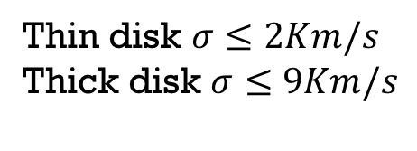
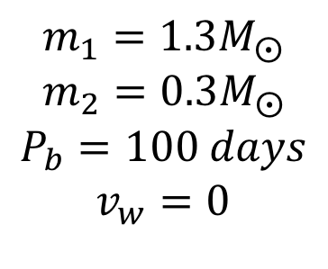

Numerical results
Important dependence on $σ and v_{w}$
$$m_{1}=1.3M_{⨀}$$
$$m_{2}=0.3M_{⨀}$$
$$P_{b}=100 days$$
$$v_{w}=0$$
Thin disk $σ≤2Km/s$
Thick disk $σ≤9Km/s$

Slide 16
Numerical results
Important dependence on $σ and v_{w}$
Thin disk $σ≤2Km/s$
Thick disk $σ≤9Km/s$

Slide 17
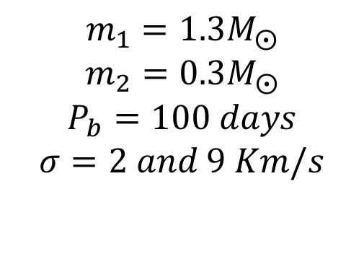
Numerical results
Important dependence on $σ and v_{w}$
$$m_{1}=1.3M_{⨀}$$
$$m_{2}=0.3M_{⨀}$$
$$P_{b}=100 days$$
$$σ=2 and 9 Km/s$$

Slide 18

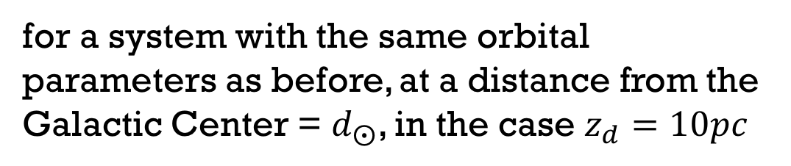
Numerical results
Important dependence on $σ and v_{w}$
for a system with the same orbital parameters as before, at a distance from the Galactic Center = $d_{⨀}$, in the case $z_{d}=10pc$
$${\dot{P}}_{b}^{DM}≈−4.2∙{10}^{−13}$$

Slide 19
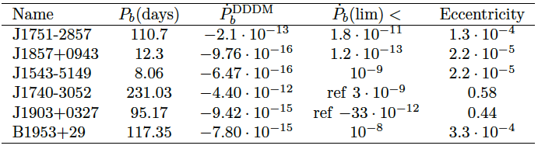
Comparison with observations
A collection of promising binary pulsars

Slide 20
Comparison with observations
A collection of promising binary pulsars
We know of more than 2300 normal pulsars and about 250 millisecond pulsars, of which about 80% are in binaries.

Slide 21

Comparison with observations
A collection of promising binary pulsars
We know of more than 2300 normal pulsars and about 250 millisecond pulsars, of which about 80% are in binaries.

Slide 22
Point out the issue in this approach

Slide 23
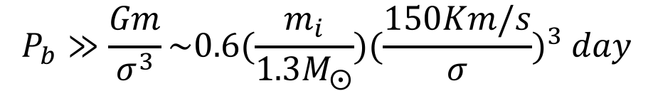
Point out the issue in this approach
We neglected the interaction between wakes
Usually one can safely do this if the wake of the i-th object disappears before the arrival of the companion
$$P_{b}≫\frac{Gm}{σ^{3}}\sim 0.6(\frac{m_{i}}{1.3M_{⨀}}){(\frac{150Km/s}{σ})}^{3} day$$
This is not strictely our case, in which dispersion is small!

Slide 24
II Approach, wakes interaction into the game

Slide 25
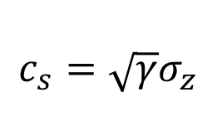
The idea: DM as a “fluid”
$$c_{s}=\sqrt{γ}σ_{z}$$
(Sound velocity)
Lora-Clavijo, F. D., Gracia-Linares, M., Guzman, F. S.,
Sep. 2014. MNRAS443, 2242-2251
Clarke, J. D., Foot, R., Jan. 2016. Plasma dark matter
direct detection. JCAP 1, 029

Slide 26
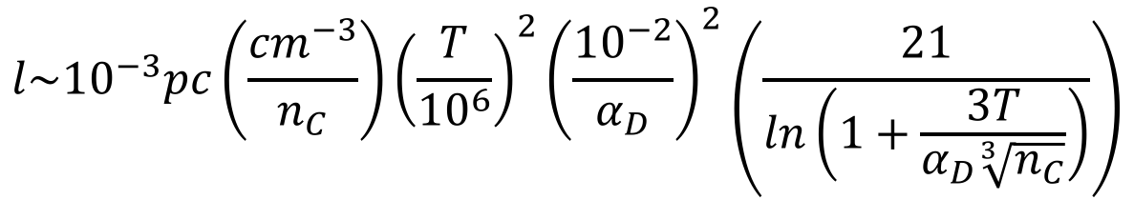

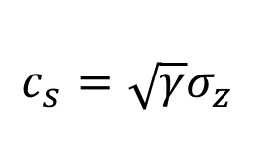
The idea: DM as a “fluid”
$$c_{s}=\sqrt{γ}σ_{z}$$
(Sound velocity)
$$l\sim {10}^{−3}pc\left(\frac{{cm}^{−3}}{n_{C}}\right){\left(\frac{T}{{10}^{6}}\right)}^{2}{\left(\frac{{10}^{−2}}{α_{D}}\right)}^{2}\left(\frac{21}{ln\left(1+\frac{3T}{α_{D}\sqrt[3]{n_{C}}}\right)}\right)$$
Mean free
path
Major axis of the binary
$$a$$
Eliot Rosenberg, JiJi Fan arXiv:1705.10341

Slide 27

The idea: DM as a “fluid”
$$c_{s}=\sqrt{γ}σ_{z}$$
(Sound velocity)
$$l\sim {10}^{−3}pc\left(\frac{{cm}^{−3}}{n_{C}}\right){\left(\frac{T}{{10}^{6}}\right)}^{2}{\left(\frac{{10}^{−2}}{α_{D}}\right)}^{2}\left(\frac{21}{ln\left(1+\frac{3T}{α_{D}\sqrt[3]{n_{C}}}\right)}\right)$$
Mean free
path
Major axis of the binary
$$a$$
Fluid regime: Knudsen number much less than one
$$Kn≡l/a≪1$$

Slide 28
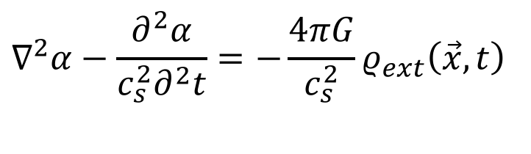
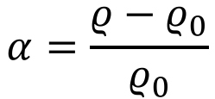
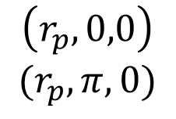
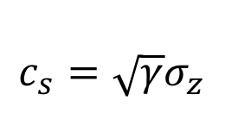
The idea: DM as a “fluid”
$$c_{s}=\sqrt{γ}σ_{z}$$
Sound velocity
$$α=\frac{ρ−ρ_{0}}{ρ_{0}}$$
$$\left(r_{p},0,0\right)$$
$$(r_{p},π,0)$$
Positions at t=0
$$∇^{2}α−\frac{∂^{2}α}{c_{s}^{2}∂^{2}t}=−\frac{4πG}{c_{s}^{2}}ρ_{ext}\left(\vec{x},t\right)$$

Slide 29
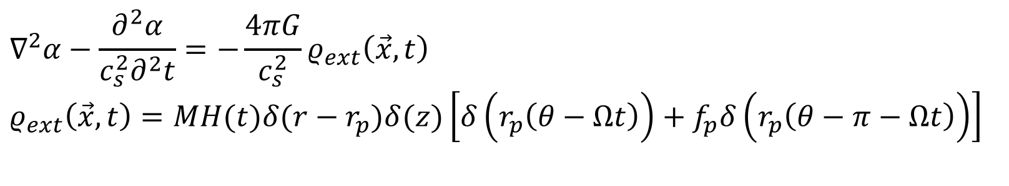
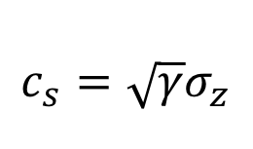
The idea: DM as a “fluid”
$$c_{s}=\sqrt{γ}σ_{z}$$
Sound velocity
$$α=\frac{ρ−ρ_{0}}{ρ_{0}}$$
$$\left(r_{p},0,0\right)$$
$$(r_{p},π,0)$$
Positions at t=0
$$∇^{2}α−\frac{∂^{2}α}{c_{s}^{2}∂^{2}t}=−\frac{4πG}{c_{s}^{2}}ρ_{ext}\left(\vec{x},t\right)$$
$$ρ_{ext}\left(\vec{x},t\right)=MH(t)δ(r−r_{p})δ(z)\left[δ\left(r_{p}\left(θ−Ωt\right)\right)+f_{p}δ\left(r_{p}\left(θ−π−Ωt\right)\right)\right]$$

Slide 30
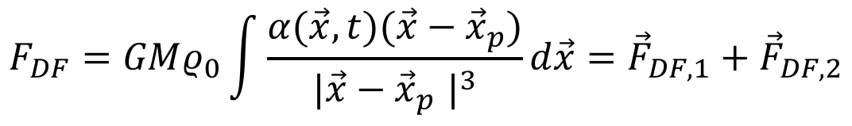
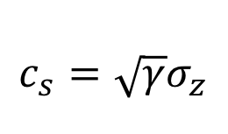
The idea: DM as a “fluid”
$$c_{s}=\sqrt{γ}σ_{z}$$
Sound velocity
$$α=\frac{ρ−ρ_{0}}{ρ_{0}}$$
$$\left(r_{p},0,0\right)$$
$$(r_{p},π,0)$$
Positions at t=0
$$∇^{2}α−\frac{∂^{2}α}{c_{s}^{2}∂^{2}t}=−\frac{4πG}{c_{s}^{2}}ρ_{ext}\left(\vec{x},t\right)$$
$$ρ_{ext}\left(\vec{x},t\right)=MH(t)δ(r−r_{p})δ(z)\left[δ\left(r_{p}\left(θ−Ωt\right)\right)+f_{p}δ\left(r_{p}\left(θ−π−Ωt\right)\right)\right]$$
$$F_{DF}=GMρ_{0}\int{\frac{α(\vec{x},t)(\vec{x}−{\vec{x}}_{p})}{{|\vec{x}−{\vec{x}}_{p}^{}|}^{3}}d\vec{x}={\vec{F}}_{DF,1}+{\vec{F}}_{DF,2}}$$

Slide 31
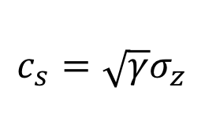
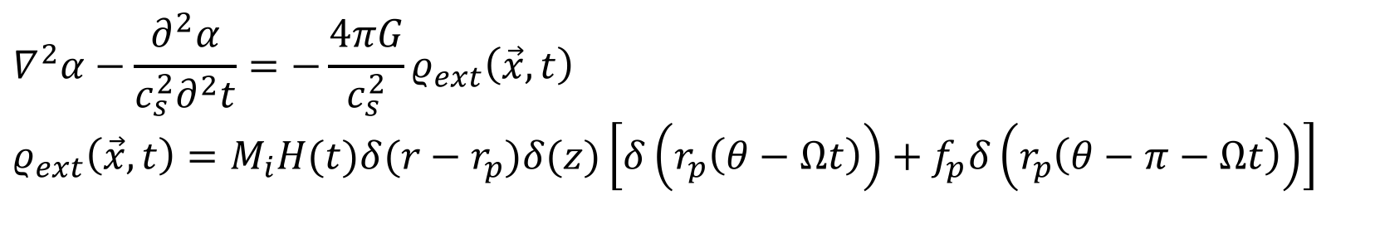
The idea: DM as a “fluid”
$$c_{s}=\sqrt{γ}σ_{z}$$
Sound velocity
$$α=\frac{ρ−ρ_{0}}{ρ_{0}}$$
$$\left(r_{p},0,0\right)$$
$$(r_{p},π,0)$$
Positions at t=0
$$∇^{2}α−\frac{∂^{2}α}{c_{s}^{2}∂^{2}t}=−\frac{4πG}{c_{s}^{2}}ρ_{ext}\left(\vec{x},t\right)$$
$$ρ_{ext}\left(\vec{x},t\right)=M_{i}H(t)δ(r−r_{p})δ(z)\left[δ\left(r_{p}\left(θ−Ωt\right)\right)+f_{p}δ\left(r_{p}\left(θ−π−Ωt\right)\right)\right]$$
$$F_{DF}=GMρ_{0}\int{\frac{α(\vec{x},t)(\vec{x}−{\vec{x}}_{p})}{{|\vec{x}−{\vec{x}}_{p}^{}|}^{3}}d\vec{x}={\vec{F}}_{DF,1}+{\vec{F}}_{DF,2}}$$
Two contributions! one due to the pertuber's own wake and the other
due to the wake of the companion
Kim, H., Kim, W.-T., ApJ665, 432-444

Slide 32


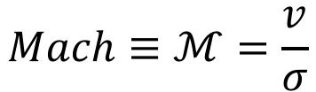

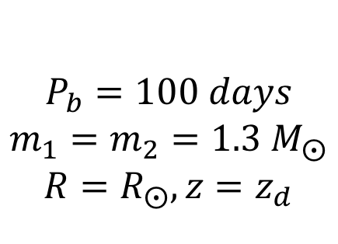
$$\frac{Fluid approach}{Collisionless approach}$$
$$F_{DF}={\vec{F}}_{DF,1}+{\vec{F}}_{DF,2}$$
$$P_{b}=100 days$$
$$m_{1}=m_{2}=1.3 M_{⨀}$$
$$R=R_{⨀}, z=z_{d}$$
$$Mach≡ℳ=\frac{v}{σ}$$
$$\sim 10\% reduction of the signal$$

Slide 33
conclusions

Slide 34
conclusions
Binary pulsars are amazing objects which can be used to put constraints on and/or prove dark matter models
Diego Blas, Diana Lopez Nacic, Sergey Sibiryakov, Phys.Rev.Lett. 118 (2017)
Vitor Cardoso, Paolo Pani, Tien-Tien Yu Phys.Rev. D95 (2017) no.12

Slide 35
conclusions
Binary pulsars are amazing objects which can be used to put constraints on and/or prove dark matter models
A more sophisticated analysis is required to include dark matter interactions

Slide 36
conclusions
Binary pulsars are amazing objects which can be used to put constraints on and/or prove dark matter models
A more sophisticated analysis is required to include dark matter interactions
It is necessary to extend the II approach to realistic cases with different masses, to make a more detailed comparison

Slide 37
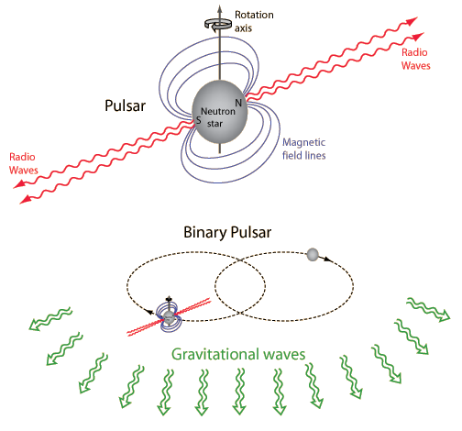
Thanks for your attention

