Slide 1
3D structure of the nucleon and
Transverse single-spin asymmetries
Motivations
3D nucleon structure
TMDs (Transverse momentum dependent distributions)
Transverse single-spin asymmetries in various (SEMI-) INCLUSIVE processes
Open issues

Slide 2
Motivations (general statements)
Nucleon: still a mysterious object despite 50 years of studies,
yet the most abundant piece of matter in the visible Universe
QCD and confinement: still to be understood
Spin: fundamental quantum degree of freedom
a tool to study the inner structure of a composite system
such as a nucleon

Slide 3
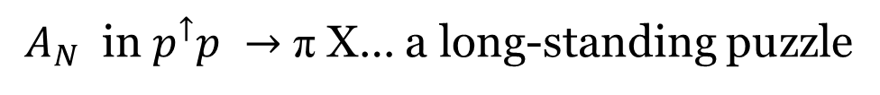

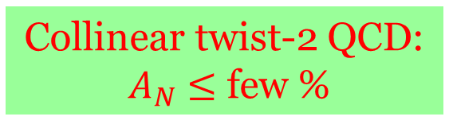
Transverse Spin effects
$A_{N}$ in $p^{↑}p →$ π X… a long-standing puzzle
$$x_{F}=2P_{L}/\sqrt{s}$$
Collinear twist-2 QCD:
$A_{N}$ $≤$ few %
Almost energy independent

Slide 4
1-D picture of the nucleon
inclusive DIS
DIS Structure
Functions
Collinear PDFs

Slide 5
(open) Physics issues
Orbital motion of quarks/gluons
Its correlation to proton spin
Intrinsic transverse momentum of quarks/gluons
Spatial distribution of quarks/gluons
3D structure
Non perturbative effects in high-energy processes
Origin of transverse/azimuthal spin asymmetries
Observables
Role of local colour gauge invariance of QCD
Factorization, universality, resummation
QCD at work

Slide 6
This talk

Slide 7
Proton spin puzzle
TMDs (or IPDs)
Non trivial decomposition [Leader, Lorcé (2014)]

Slide 8
TMDs: How can we access them?
A step backward: Collinear approach
The key point is: Factorization
(separation btw large/short distance physics)
Evolution with hard scale
→ DGLAP eqs.
A cornerstone in pQCD

Slide 9



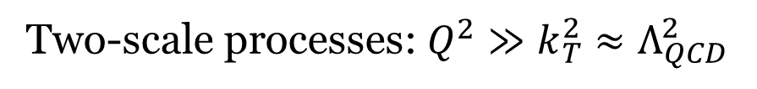
To access directly the TMDs:
Two-scale processes: $Q^{2}≫k_{T}^{2}$ $≈Λ_{QCD}^{2}$
Drell-Yan $pp → l^{+} l^{− } X$
$$e^{+}e^{−}→ ππ X$$
SIDIS $lp→l^{′}h X$
TMD factorization proven

Slide 10

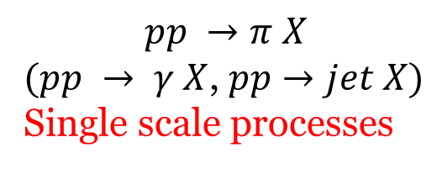
And possibly in processes like
And more
$$pp →π X$$
$(pp → γ X$, $pp→jet X)$
Single scale processes
$$pp→ π jet X$$

Slide 11


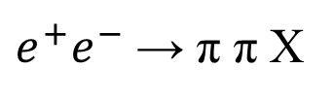
Where can we access TMDs?
EIC
SIDIS
Drell-Yan
$e^{+}e^{−}$ → π π X
$pp→ π X , pp→ π jet X$

Slide 12
Spread all over the world

Slide 13
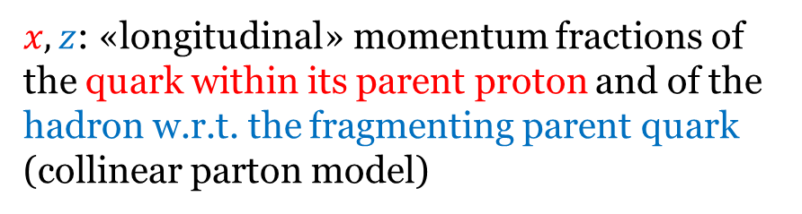

TMDs and unpolarized cross sections
SIDIS multiplicities
$$l p →l^{′}h X$$
$x,z$: «longitudinal» momentum fractions of the quark within its parent proton and of the hadron w.r.t. the fragmenting parent quark (collinear parton model)
Factorized
Gaussian
forms

Slide 14


${<k}_{⊥}^{2}>$ = 0.57-0.38 ${GeV}^{2}$
<$p_{⊥}^{2}>$ = 0.12-0.18 ${GeV}^{2}$
Anselmino, et al. (2014)
Signori, Bacchetta, Radici, Schnell (2013)

Slide 15
TMDs: flavour structure
Gaussian widths
up < down < sea ????
Signori, Bacchetta, Radici, Schnell (2013)
to be further explored

Slide 16
Theory: factorization and evolution
Collinear approach
Evolution → DGLAP eqs.
TMD approach…more involved

Slide 17
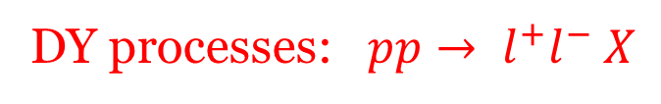
An example: DY process
Extra gluons:
Wilson lines, operators between parton fields in the correlator function
Soft factors, vacuum expectation values of further Wilson lines, absorbed in the TMDs)
DY processes: $pp→ l^{+}l^{−} X$
Wilson lines: path-ordered exponential of the gauge field ensuring local gauge invariance, but inducing some process dependence

Slide 18
TMD factorization approaches
Seminal paper
TMD framework
Tremendous progress

Slide 19
TMD Factorization and evolution (I)
DY processes
Collins approach (2011)
Collinear PDF
pQCD
Non perturbative parts

Slide 20
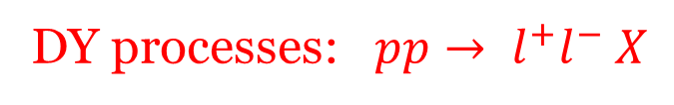
TMD Factorization and evolution (II)
DY processes: $pp→ l^{+}l^{−} X$
Echevarria, Idilbi, Scimemi (2012,13,14)
UD, Echevarria, Melis, Scimemi (2014)
TMD in b space

Slide 21
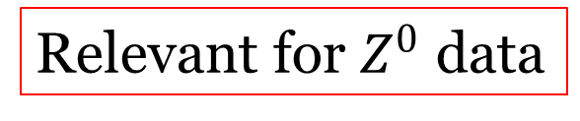
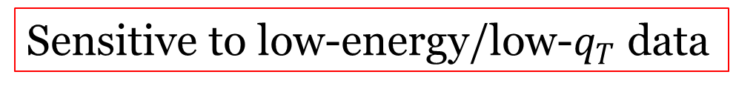
Non-perturbative input and accuracy
Both needed
Relevant for $Z^{0}$ data
Sensitive to low-energy/low-$q_{T}$ data

Slide 22

Fit to Drell-Yan
and $Z^{0}$ production data
TMD evolution at NNLL (SCET)
UD, Echevarria, Melis, Scimemi (2014)
(223 data points)
Low energy
Tevatron

Slide 23
Scale dependence: NLL vs. NNLL
Low energy
NLL
NNLL
Tevatron
Strong reduction at NNLL

Slide 24
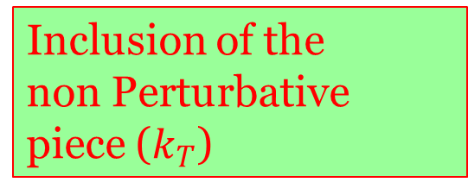

TMDs at LHC
Predictions from NNLL fit
$$pp→Z X$$
Pure resummed pQCD
Inclusion of the
non Perturbative
piece ($k_{T}$)

Slide 25
TMDs and spin
collinear
T-odd

Slide 26
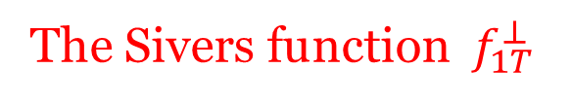
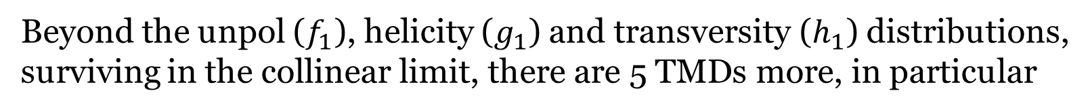
Beyond the unpol ($f_{1}$), helicity ($g_{1}$) and transversity ($h_{1}$) distributions,
surviving in the collinear limit, there are 5 TMDs more, in particular
The Sivers function $f_{1T}^{⊥}$
Sivers (1989)
Correlation between the spin of the proton and the parton transverse momentum

Slide 27
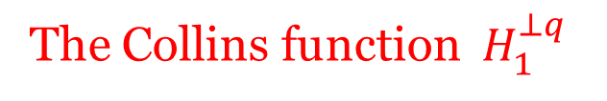
Analogously, one can define TMDs in the fragmentation process.
In particular, for its relevance
The Collins function $H_{1}^{⊥q}$
Collins (1992)
Correlation between the spin of the fragmenting quark and
the hadron transverse momentum

Slide 28
Sivers and Collins functions extensively studied
theoretically, experimentally and phenomenologically
CLEAR evidence from data
HERMES, COMPASS
SIDIS
Collins
Sivers
First phase: analysis with DGLAP evolution
Second phase (just started): TMD evolution

Slide 29
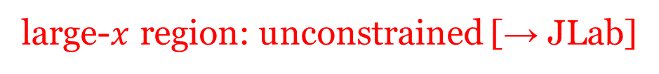
Extracted Sivers functions
TO-CA and PV groups
large-$x$ region: unconstrained [→ JLab]
sea region: unconstrained [→ EIC]
Aybat, Collins,
Qiu, Rogers (2012)
Effect of the TMD evolution

Slide 30
Distortion in the transverse plane
Non zero Sivers effect related to parton orbital angular momentum

Slide 31
Modified universality of the Sivers function
Collins (2012)
Final state interactions in SIDIS
Initial state interactions in DY
A clear-cut test
If falsified:
- misunderstanding of final-state interacts. leading to T-odd effects
- missing points in QCD factorization (TMD and collinear) [most severe scenario]

Slide 32
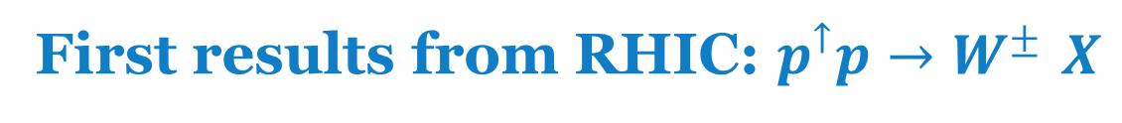
First results from RHIC: $p^{↑}p→W^{± }X$
STAR Collaboration (2016)
No TMD evolution
First hint at the sign change,
but large exp. errors and …
Kang et al (2016)

Slide 33
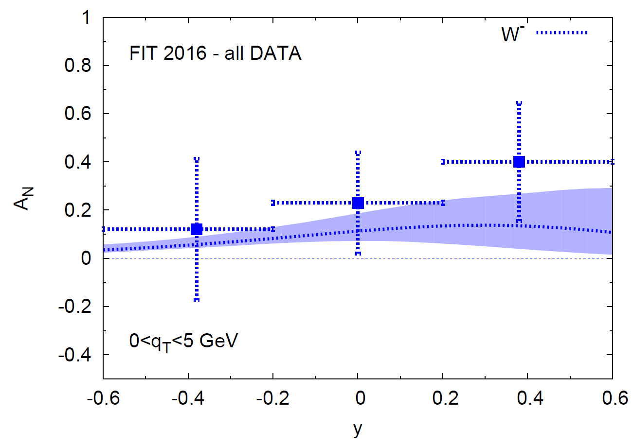
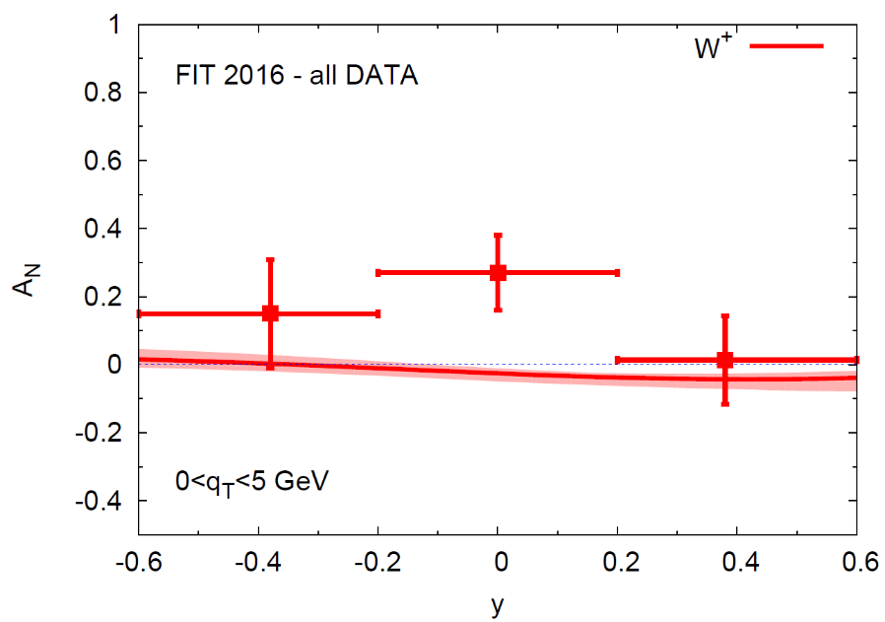
New analysis: Anselmino, Boglione, UD, Murgia, Prokudin (2016)
Sign reversed

Slide 34
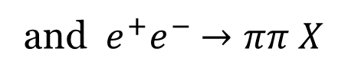
Collins function & transversity
Combined analysis of
SIDIS
and $e^{+}e^{−}$ $→ππ X$
Without TMD evolution
Anselmino, Boglione, UD,
Melis, Murgia, Prokudin (2015)

Slide 35
Kang, Prokudin, Sun, Yuan (2015)
Same analysis but with TMD evolution
No compelling TMD evolution yet
Remember: SSAs are ratios….

Slide 36
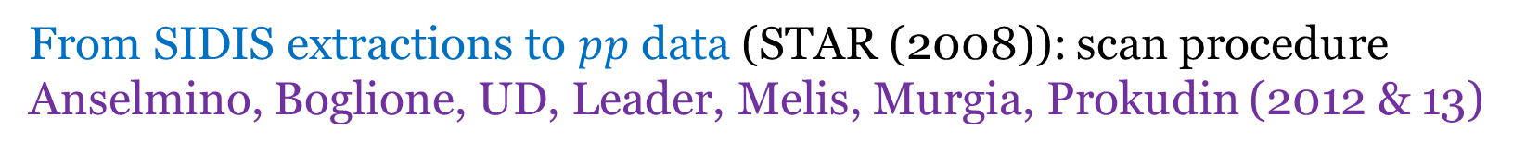
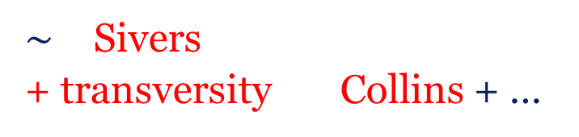
Back to $A_{N}$ : further evidence of Sivers and Collins effects
$\sim$ Sivers
+ transversity Collins + …
In a phenomenological TMD scheme
Non separable
From SIDIS extractions to $pp$ data (STAR (2008)): scan procedure
Anselmino, Boglione, UD, Leader, Melis, Murgia, Prokudin (2012 & 13)
Sivers effect alone
Collins effect alone
Proper
combination?
in progress

Slide 37

Higher-twist contributions to $A_{N}$
Collinear factorization: proven
Qiu, Sterman (1991)
Twist-three functions corresponding, and related, to the TMDs, like
Boer, Mulders, Piljman (2003)
Using these relations one is not able to describe $A_{N}$ (sign mismatch issue)
A completely new twist-3 fragm. function seems to be able (necessary) to explain $A_{N}$
$A_{N}$ in $pp→γ X$ ideal to disentangle the two approaches ($A_{N}$ with different sign)

Slide 38

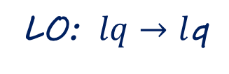
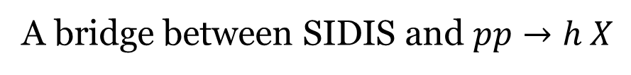

$A_{N}$ in $l p→ π X$ (single-scale process)
Inclusive process
One hard scale $P_{T}$
A bridge between SIDIS and $pp→h X$
From SIDIS to $l p→h X$: test of a unified TMD approach
LO: $lq→l$q
Anselmino, Boglione, UD, Melis, Murgia, Prokudin (2010&14)
Fairly good description of HERMES data but
Inclusive events: final lepton scattered almost collinear $Q^{2}≈0$

Slide 39
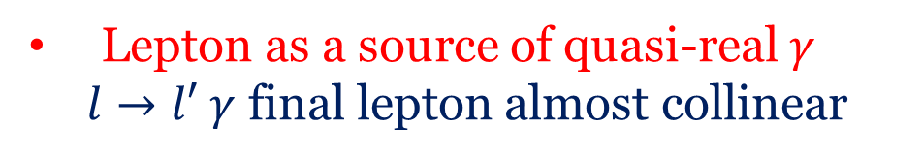
Quasi-real photon exchange
Lepton as a source of quasi-real $γ$
$l→l′ γ$ final lepton almost collinear
Weizsäcker-Williams approximation
Reanalysis of SSAs (and unpol. xsecs): UD, Flore, Murgia 2017

Slide 40



SSAs: Only Sivers and (marginally) Collins effects sizeable
HERMES data (2014)
Predictions from SIDIS extractions
0.1
Inclusive data
$$π^{−}$$
0.1
Anti-tagged
0
0
$$π^{+}$$
$$π^{−}$$
-0.1
-0.1
WW: big improvement!
TMD scheme seems fine

Slide 41

Collins effect: from SIDIS to $pp→ π jet X$
$$A_{N}^{W}=$$
Sivers effect
Collins effect
Collins-like effect
UD, Murgia, Pisano (2011)

Slide 42
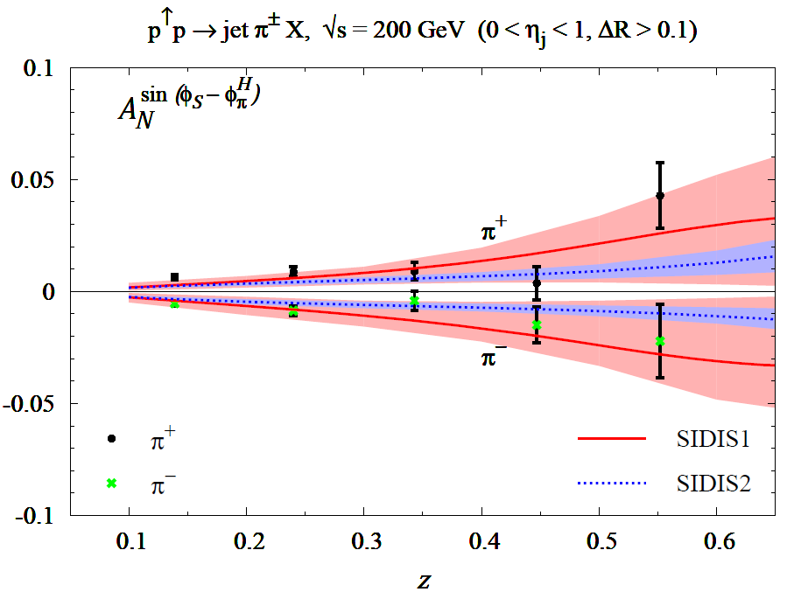
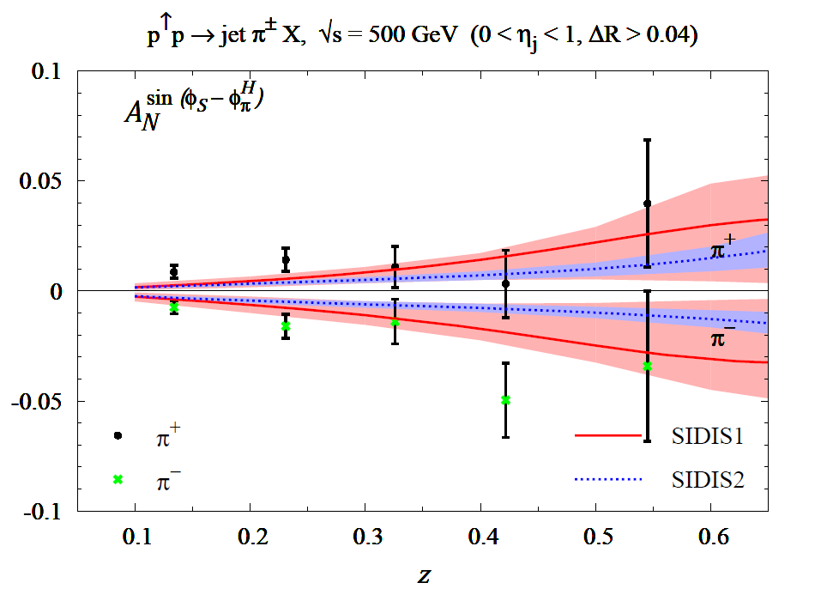
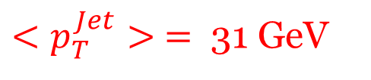
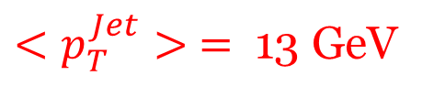
$<p_{T}^{Jet}> =$ 13 GeV
$<p_{T}^{Jet}> =$ 31 GeV
200 GeV
500 GeV
Predictions
without TMD evolution
UD, Murgia, Pisano,
in progress
Data: PHENIX Coll. (2015)
Universality of the Collins function
mild (or no) TMD evolution

Slide 43
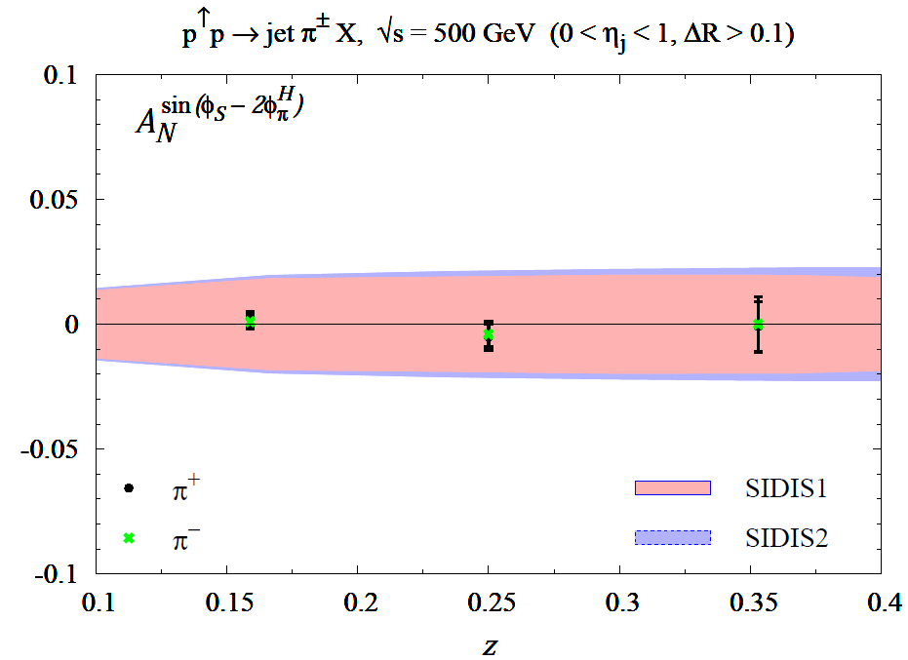
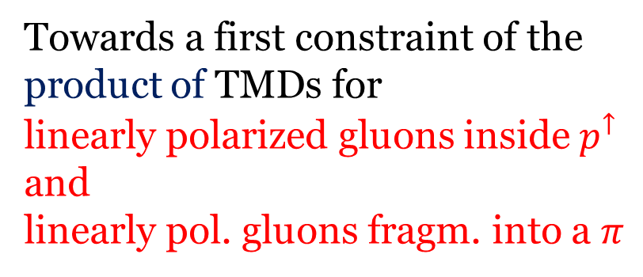

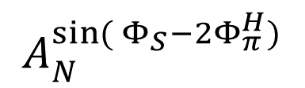
Collins-like contribution
Defined modulation
$$sin({Φ_{S}−2Φ_{π}^{H})}$$
$$A_{N}^{sin({Φ_{S}−2Φ_{π}^{H})}}$$
Positivity bound
helicity flip of the gluon
Towards a first constraint of the
product of TMDs for
linearly polarized gluons inside $p^{↑}$
and
linearly pol. gluons fragm. into a $π$
PHENIX

Slide 44
Open issues in TMD phenomenology
TMD evolution and its relevance
An example
Kang (2015)
w/o TMD evolution
Role of non perturbative input choices
Transverse momentum dependence in SIDIS and its consistency with DY
TMD factorization breaking effects in $pp→ π X , pp→jet jet X$ (are they sizeable???)
Gluon TMDs at low x and parton saturation, TMD factor. vs. Color Glass Condensate

Slide 45
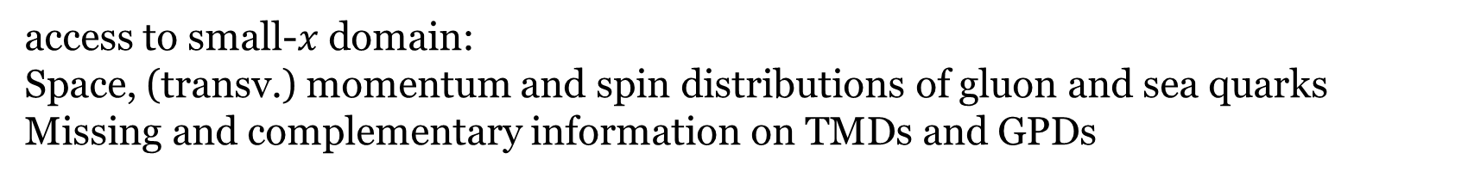
Future → EIC
access to small-$x$domain:
Space, (transv.) momentum and spin distributions of gluon and sea quarks
Missing and complementary information on TMDs and GPDs
JLAB

Slide 46
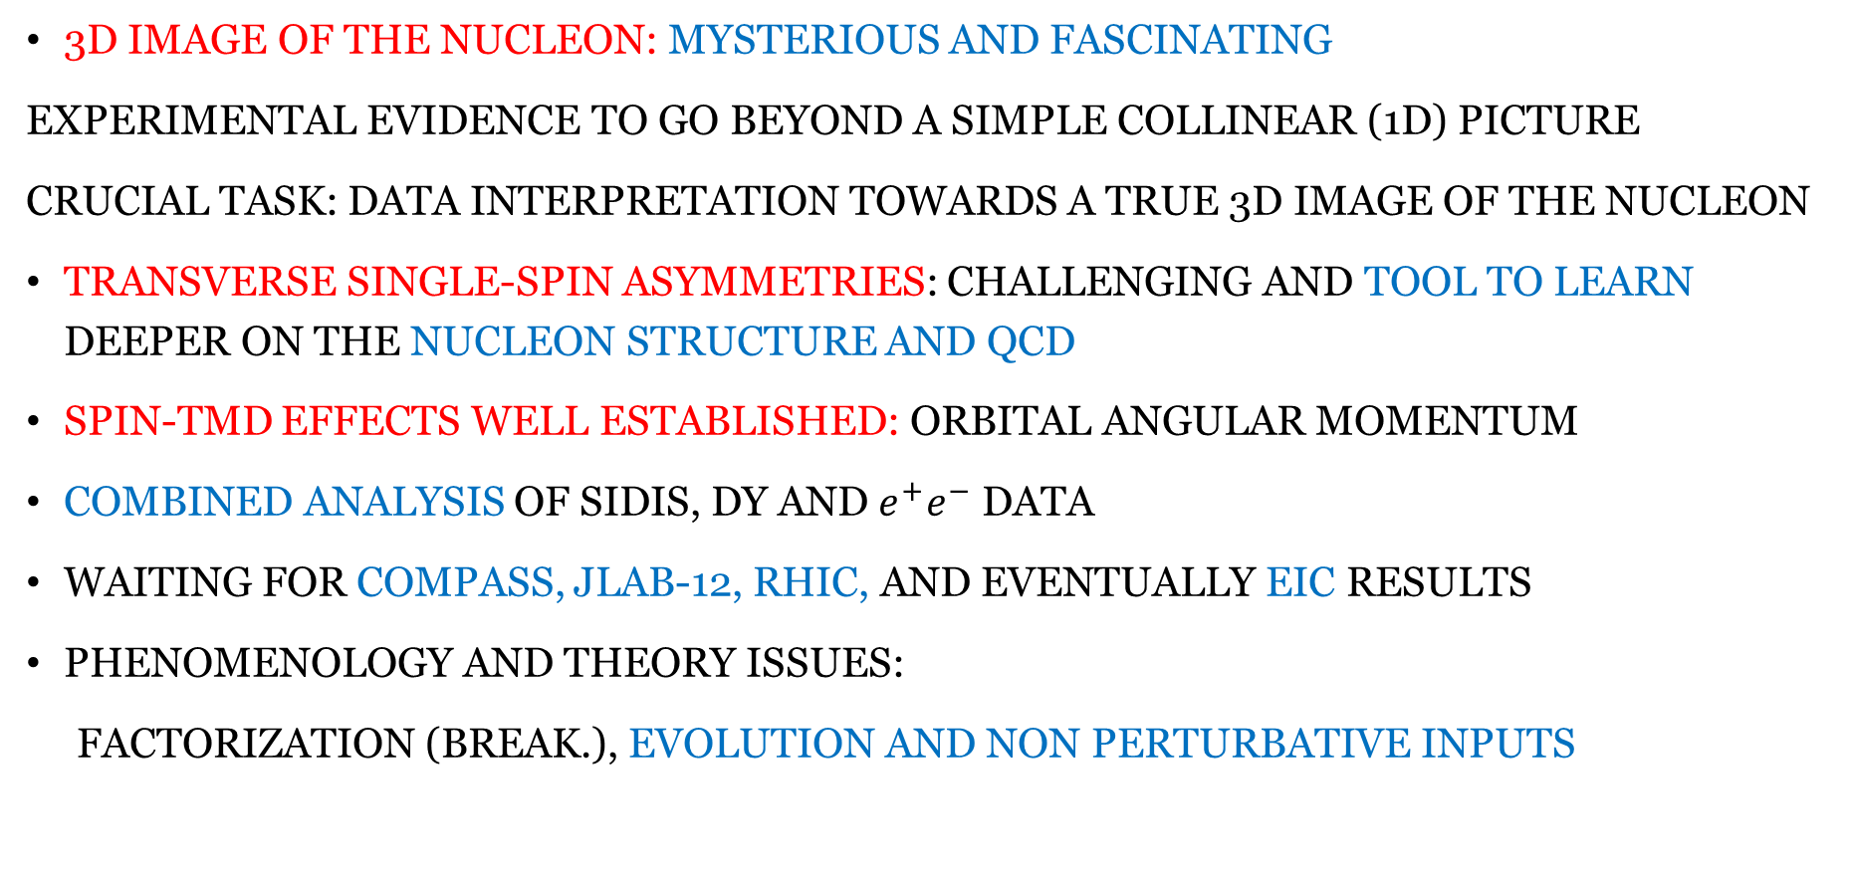
Conclusions and open issues
3D image of the nucleon: mysterious and fascinating
Experimental evidence to go beyond a simple collinear (1D) picture
CRUCIAL TASK: DATA Interpretation towards a true 3D image of the nucleon
Transverse single-spin asymmetries: challenging and tool to learn deeper on the nucleon structure and QCD
Spin-TMD effects well established: orbital angular momentum
combined analysis OF SIDIS, DY and $e^{+}e^{−}$ DATA
Waiting for COMPASS, Jlab-12, RHIC, and eventually EIC results
Phenomenology and theory issues:
factorization (break.), evolution and non perturbative inputs
THANK YOU

Slide 47
BACK-UP SLIDES

Slide 48



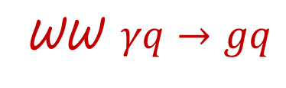
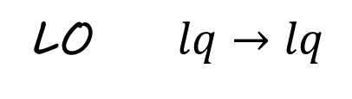


Reanalysis within a TMD scheme + Weizsäcker-Williams approx.
UD, Flore, Murgia (in preparation) - UD@QCD Evolution 2016
Unpolarized
cross sections
LO + WW
LO $lq→lq$
$P_{T}=1.4$GeV
WW $γq→gq$
$$γg→q\overline{q}$$
$$π^{+}$$
$$π^{−}$$
NOTICE ${ x}_{F}>0$
backward scattering
LO
WW piece: 50-70% of the total

Slide 49

Access to the gluon Sivers function
$A_{N}$ at mid-rapidity
PHENIX Collaboration data (2014)
All other effects are washed out
UD, Murgia, Pisano JHEP09 (2015)

Slide 50

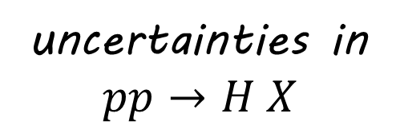
TMDs at LHC (II)
Ferrera (2014)
$$pp→Z X$$
uncertainties in
$$pp→H X$$
Inclusion of the non perturbative piece

